Slide 1
CIS 22C Team Projects: Movies
Fall 2014 Team 1
Ethan Wong Alex Hua
Brandon Chai Anthony Liu
Notes:
Tony

Slide 2
Introduction
A menu-driven program that implements binary search tree and hash table algorithms based on movie data from an input file.
Fields: movie title (unique key), year released, genre, rating
Allows user to
Insert
Remove
Undo remove
Search by unique key (movie title)
Display hash table
Print hashed table
Print sorted list,
Print indented tree
Show hash statistics
Show menu
Save data to file.
Notes:
Tony

Slide 3
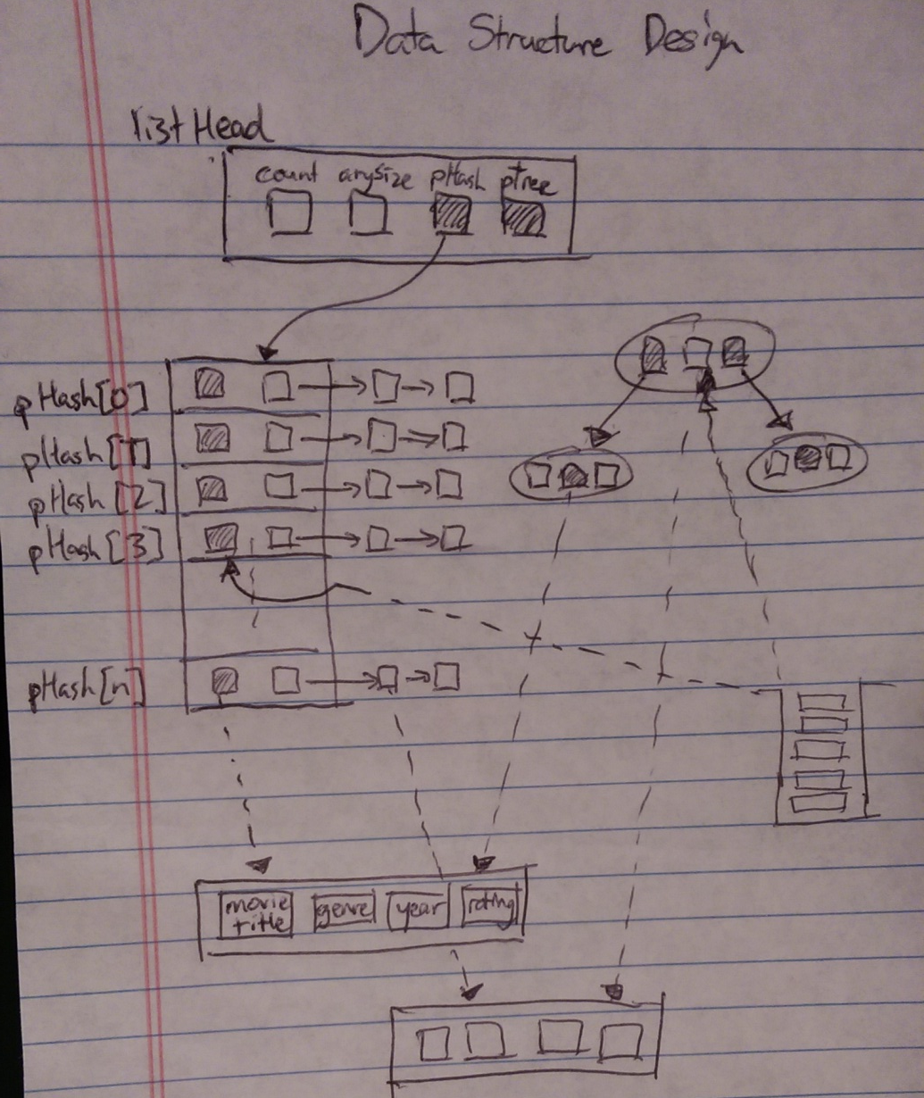
Data Structure Design
Notes:
Ethan

Slide 4
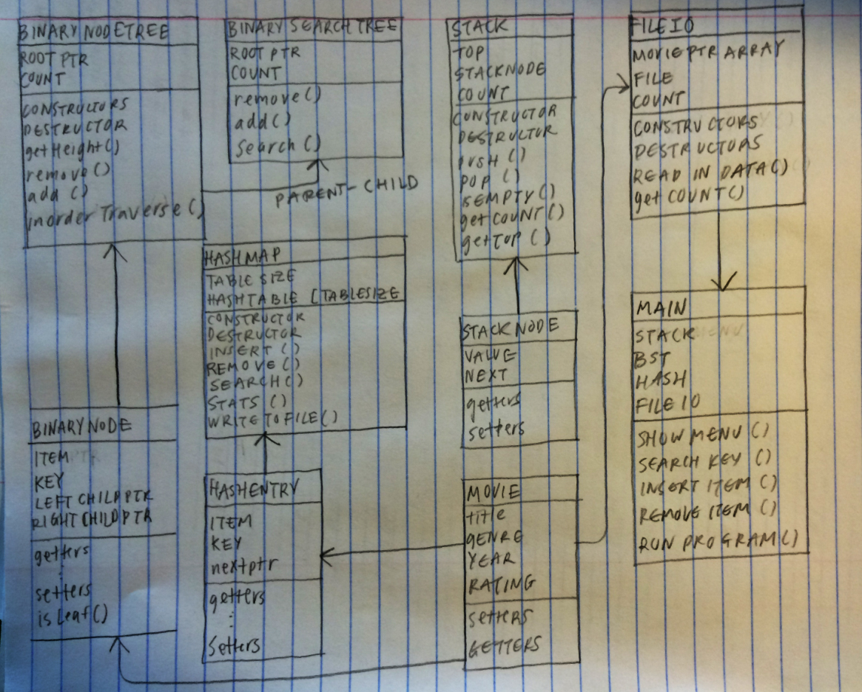
UML Diagram
Notes:
Brandon

Slide 5
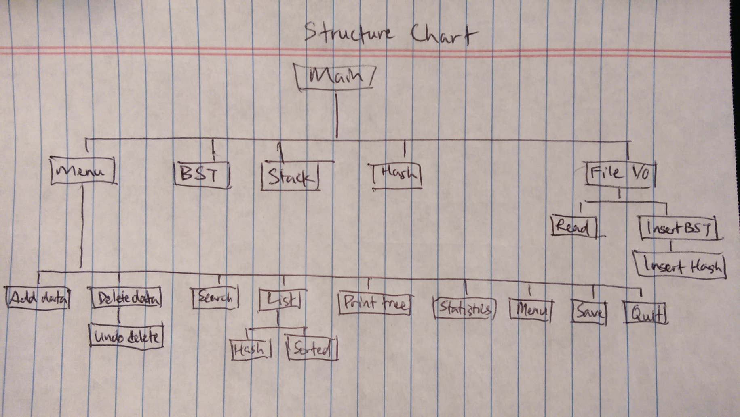
Structure Chart
Notes:
Tony

Slide 6
Team Breakdown
Ethan Wong – Main, File I/O, Debugging
Alex Hua – Main, Menu, Input Validation, Documentation
Brandon Chai – BST, Hash Algorithms, Screen Output
Anthony Liu – Team Coordinator, Testing, Presentation
Notes:
Alex

Slide 7
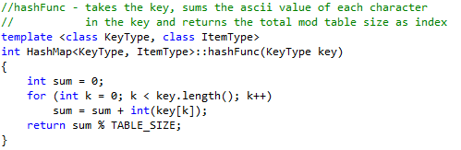
Hash Function
Notes:
Alex

Slide 8
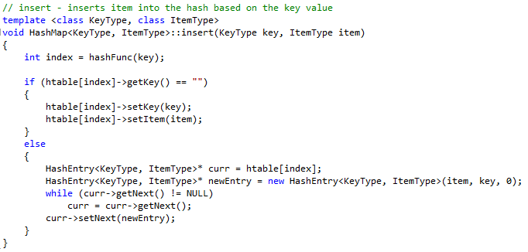
Collision Resolution Method
We used linked lists for collision resolution
Notes:
Alex

